Slide 1
Optimizing Generative AI On ARM (Chapter 1)
Oliver Grainge

Slide 2
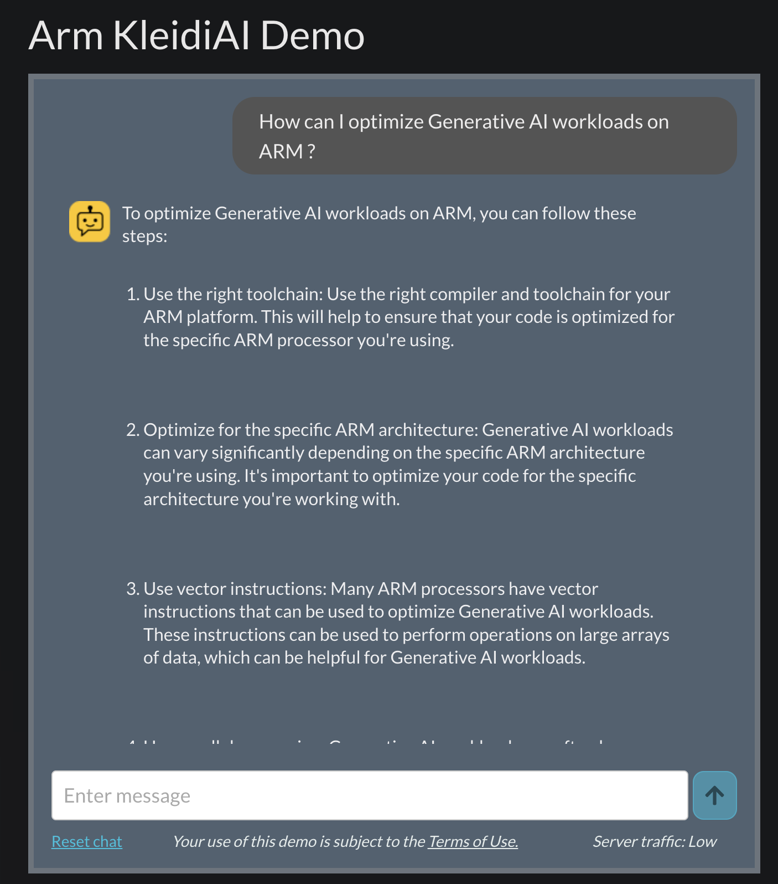
Course Introduction
AI is becoming pervasive in today’s ecosystem
Whether it is the Cloud or the Edge, Generative AI applications are becoming increasingly capable
Examples:
TimeKettle’s real-time on-device language translation
Apple’s on-device OpenELM language assistant
Perplexity.ai’s Cloud Answer Engine
And many more …
Notes:
AI is becoming a key part of today's technology landscape, influencing both Cloud-based and Edge applications. Generative AI is rapidly advancing, making real-time and on-device AI more feasible. There is a distinction between on-device AI and Cloud AI. On-device AI offers lower latency, improved privacy, and offline capabilities, as seen in TimeKettle’s translation and Apple’s OpenELM assistant.
Cloud AI can handle larger models and more complex tasks, like Perplexity.ai’s Answer Engine.
Optimizing AI for Arm involves several key strategies. Using the right toolchain ensures efficient compilation for Arm processors.
Optimizing for the specific Arm architecture can significantly improve performance.
Leveraging vector instructions allows AI workloads to efficiently process large amounts of data.
The KleidiAI demo provides guidance on optimizing AI workloads on Arm. It highlights practical steps to enhance performance and efficiency.
This can be useful for developers working on Arm-based AI applications.

Slide 3


Course outline
This course will provide you with the understanding and practical experience in deploying and optimizing generative AI workloads on Cloud and on device CPU’s. The course consists of two parts, a set of 4 lectures and 3 labs.
Lecture 1: Challenges Facing Cloud and Edge GenAI Inference
Lecture 2: Generative AI Models
Lecture 3: ML Frameworks and Optimized Libraries
Lecture 4: Optimization for CPU Inference
Lab 1: Optimizing Generative AI Workloads with Embedded Arm Processors
Lab 2: Optimizing Generative AI Workloads on Arm Server Processors
Lab 3: Comparative Inference Benchmarking on Arm Server and Edge Devices
Notes:
This course covers both theoretical and practical aspects of optimizing generative AI on Arm CPUs.
The lecture series introduces challenges in inference, different machine learning (ML) model types, and optimization techniques.
The labs provide hands-on experience with optimizing AI workloads on Arm Edge and Cloud processors.
The final lab focuses on benchmarking and comparing inference performance across different Arm-based environments.
By the end of the course, participants will have the skills to deploy and optimize AI models efficiently on Arm hardware.

Slide 4
Challenges Facing Cloud and Edge GenAI Inference
Navigating Memory Constraints and Architectural Differences

Slide 5
Lecture 1 Learning Outcomes
Understanding Memory Constraints: Understand how limited memory impacts AI model deployment on Edge devices
03
Recognize Generative AI Trends: Recognize the exponential growth of Model Compute and Data and its implication for inference.
01
Device Architecture Differences: Comprehend the fundamental differences between CPU and GPU processor architectures.
02
Understanding Computational Constraints: Learn how device throughput affects AI model deployment on Edge devices.
04
Notes:
Generative AI models are growing rapidly in size and complexity, impacting inference efficiency.
CPUs and GPUs have distinct architectural differences that influence AI performance and optimization strategies.
Memory constraints are a key challenge for deploying AI on Edge devices, requiring careful optimization.
Computational constraints, such as device throughput, affect model execution and real-time performance on Edge hardware.

Slide 6

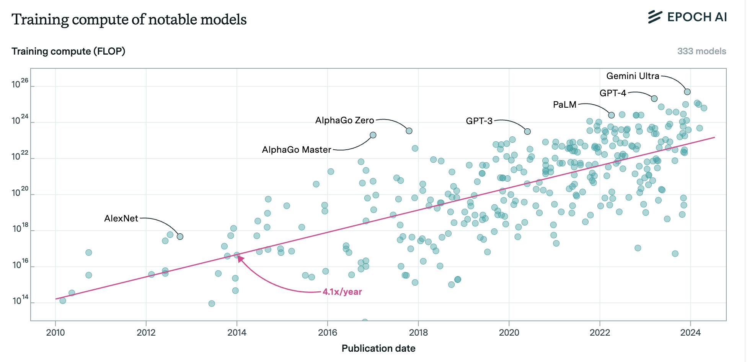
Model Size Trends
Scaling the training and inference of GenAI models in compute makes them more capable.
Sevilla, J., & Roldán, E. (2024). Training Compute of Frontier AI Models Grows by 4-5x per Year. Epoch.AI. https://epoch.ai/blog/training-compute-of-frontier-ai-models-grows-by-4-5x-per-year.
Sutton, R. S. (2019). The Bitter Lesson. http://www.incompleteideas.net/IncIdeas/BitterLesson.html
Notes:
The compute required to train leading AI models has been increasing exponentially, growing by 4-5x per year.
More compute enables more capable models, but also raises challenges in efficiency, scalability, and deployment.
Rich Sutton’s Bitter Lesson emphasizes that brute-force computation, rather than human-designed heuristics, has driven AI breakthroughs.
This trend suggests that optimizing AI workloads for efficient computation is critical, especially for deployment on Edge and Cloud hardware.
While scaling compute improves AI performance, making models efficient for real-world use remains a key challenge.

Slide 7
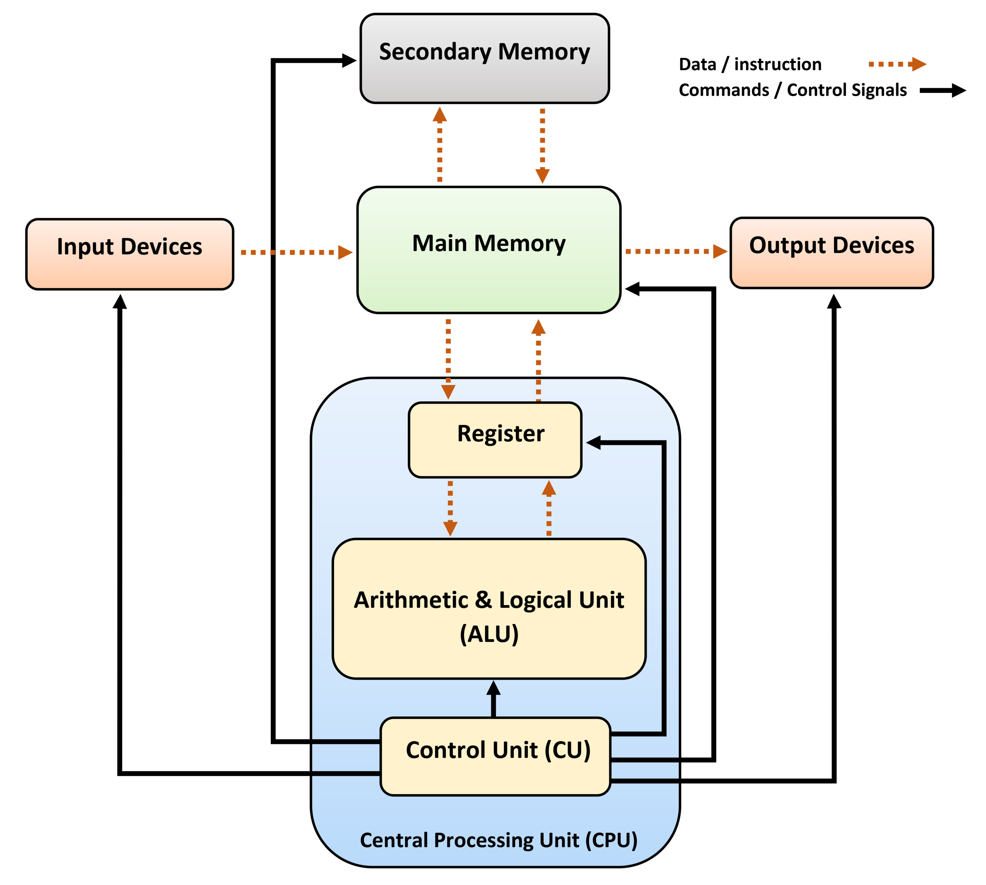
CPU Architecture Overview
Key Components
Arithmetic Logic Unit (ALU): Performs mathematical calculations and logical operations.
Control Unit (CU): Manages and directs the flow of data between the CPU, memory, and hardware components.
Registers: High-speed storage locations that temporarily hold instructions, addresses, and data being processed.
Features:
Advanced Control Logic: Designed to efficiently manage a wide range of tasks, enabling execution of complex instructions.
Optimized Single-Thread Performance: Ensures high per-core efficiency, reducing latency for computationally intensive operations.
Branch Prediction & Out-of-Order Execution: Enhances CPU efficiency by reducing pipeline stalls and ensuring continuous instruction execution.
Notes:
The CPU consists of core components including the Arithmetic Logic Unit (ALU), Control Unit (CU), and Registers.
The ALU handles arithmetic calculations and logical operations crucial for processing AI workloads.
The Control Unit manages data flow between CPU, memory, and external hardware components.
Registers provide rapid access storage, essential for fast execution of instructions.
CPU features such as advanced control logic, optimized single-thread performance, and branch prediction improve efficiency and performance.
Branch prediction and out-of-order execution techniques reduce stalls, keeping instruction pipelines active and improving throughput.

Slide 8
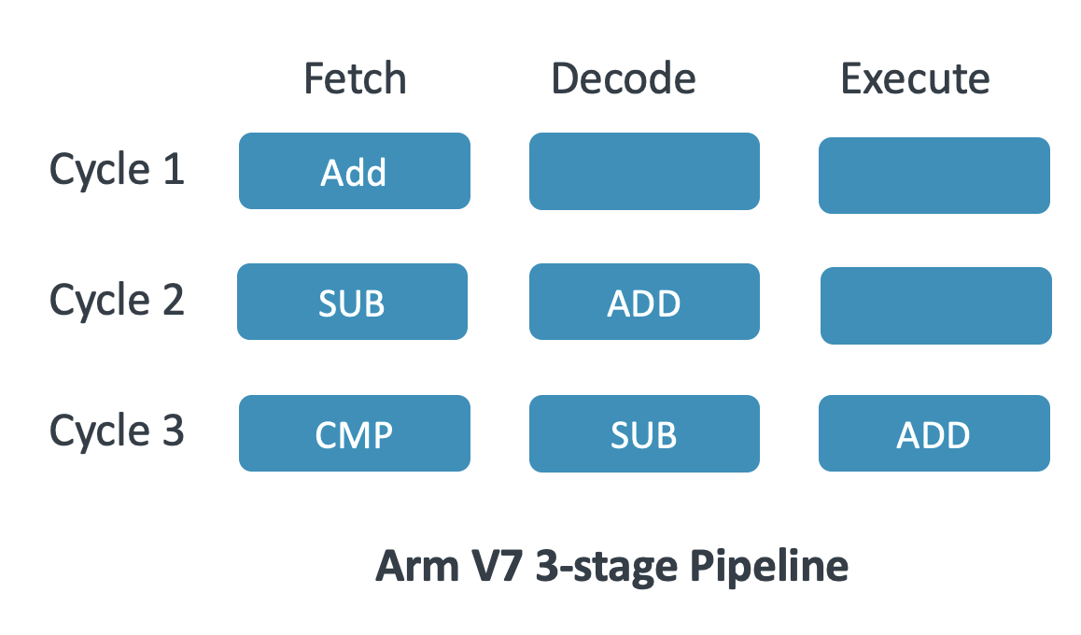
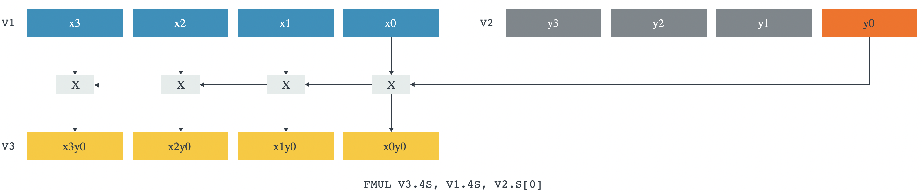
How CPUs Are Optimized
Instruction Level Parallelism
Pipelining: Executes multiple stages (fetch, decode, execute) simultaneously for higher throughput.
Superscalar Execution: Allows multiple instructions per clock cycle using parallel execution units.
Data Level Parallelism
Single Instruction Multiple Data (SIMD) allow a single instruction to act on multiple data elements e.g. (Arm Neon, SVE).
Scalable Matrix Extension (SME), available on Arm enables 2D data parallelism.
Branch Prediction
Speculative Execution: Predicts branch outcomes to keep the pipeline full, reducing stalls
Neon Vector Multiplication
Notes:
CPUs improve performance through instruction-level parallelism, allowing multiple instructions to be executed at the same time.
Pipelining breaks down instruction execution into stages (fetch, decode, execute), increasing throughput by processing multiple instructions in parallel.
Superscalar execution enables multiple instructions per clock cycle by using parallel execution units.
Data-level parallelism allows a single instruction to operate on multiple data points at once. This is used in SIMD (Single Instruction Multiple Data) architectures like NEON and SVE.
Scalable matrix extension (SME) enhances parallelism further by enabling efficient 2D data processing.
Branch prediction and speculative execution help keep the instruction pipeline full by predicting branch outcomes, reducing stalls and improving efficiency.

Slide 9
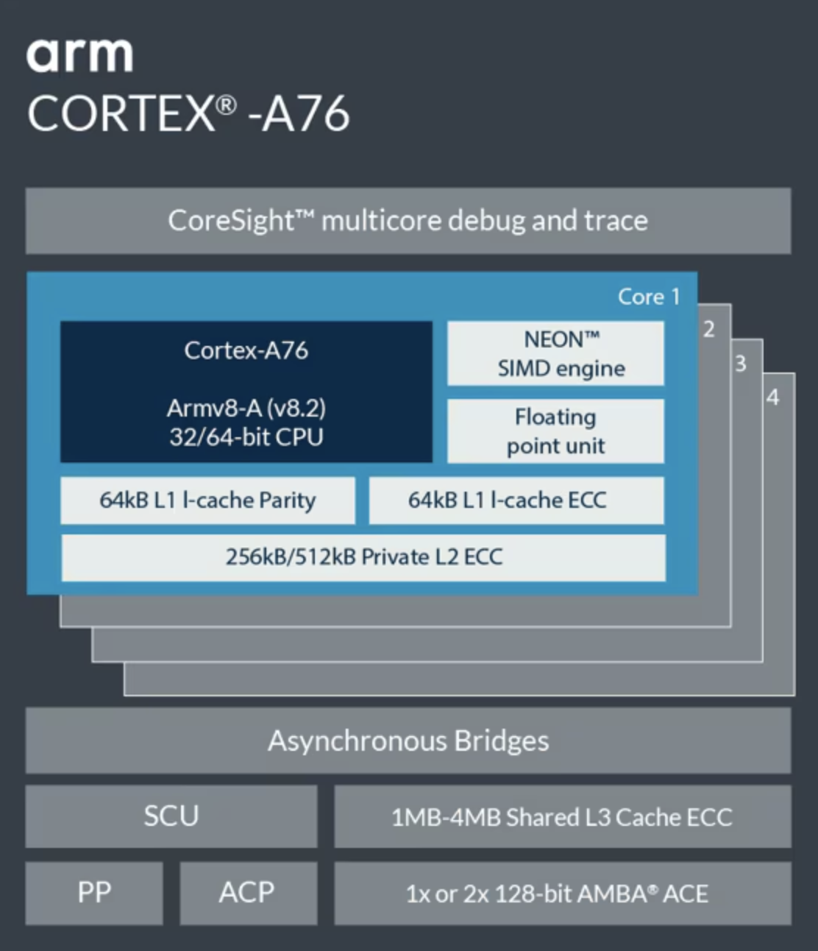
How CPUs Are Optimized
Cache Optimization
Cache Size & Associativity: Optimizing these reduces cache misses, reducing latency and energy consumption.
Prefetching: Predicts and loads required data in advance to minimize memory delays.
Power Efficiency
Frequency Scaling: Adjusts CPU speed dynamically for power and performance balance.
Low Power States: Reduces power consumption during idle periods.
Multi-Core Architectures.
Parallel Processing: Utilizes multiple cores to handle tasks concurrently.
Arm Coretex-A76 Processor (Raspberry Pi 5)
Notes:
Cache optimization reduces latency and energy consumption by optimizing cache size and associativity to minimize cache misses.
Prefetching helps improve performance by predicting and loading required data in advance, reducing memory delays.
Power efficiency is improved through frequency scaling, which dynamically adjusts CPU speed to balance power and performance.
Low power states help reduce power consumption when the CPU is idle, making processors more energy-efficient.
Multi-core architectures improve performance using parallel processing, allowing multiple tasks to be handled concurrently.

Slide 10
GPU Architecture Overview
Definition and Purpose
GPU (Graphics Processing Unit): A specialized processor designed for parallel computing.
Originally used for graphics rendering, now widely used in AI, scientific computing, and data processing.
Key Components
Compute Units (SMs, CUs, EUs).
Parallelism Models
SIMD (Single Instruction Multiple Data).
SIMT (Single Instruction Multiple Threads).
Memory Hierarchy:
Global/VRAM Memory: High-bandwidth memory for large datasets but with higher latency.
Shared/Local Memory: Reduces memory access times but limited in size.
Registers & Caches: Essential for performance but require careful management.
GPU Challenges:
Parallel focus: Not ideal for serial tasks.
Branching overhead: “If” statements SIGNIFICANTLY reduce efficiency.
High latency: Single-thread operations are slow.
Notes:
GPUs are specialized processors designed for parallel computing, originally developed for graphics but now widely used in AI and scientific computing.
Key components include compute units, which execute parallel workloads efficiently.
GPUs use parallelism models such as SIMD, which processes multiple data points simultaneously, and SIMT, which manages multiple threads efficiently.
The memory hierarchy includes high-bandwidth VRAM for large datasets, shared memory for fast access within groups of threads, and registers for high-speed operations.
Despite their advantages, GPUs face challenges such as inefficiency with serial tasks, high branching overhead when handling conditional statements, and latency issues in single-threaded operations.

Slide 11
How GPUs Are Optimized
Maximizing Parallelism
Thread Management: Organizing threads efficiently to maximize throughput.
Occupancy Optimization: Maintaining high active threads per compute unit to reduce latency.
Memory Optimization
Memory Coalescing: Aligning memory accesses to improve bandwidth and reduce latency.
Shared Memory Utilization: Using fast shared memory to minimize reliance on slower global memory.
Supported Precisions
Balancing between lower precision (e.g., FP16) and higher precision (e.g., FP32) to optimize performance and resource usage based on application requirements.
MMA units
Matrix Acceleration for AI: Specialized compute units (e.g., Tensor Cores) speed up mixed-precision operations, but dedicated AI accelerators (e.g., ARM NPUs) offer better efficiency for low-power applications.
Notes:
GPUs maximize parallelism through efficient thread management and occupancy optimization, ensuring high throughput and low latency.
Memory optimization techniques like memory coalescing align memory accesses to improve bandwidth, while shared memory utilization reduces reliance on slower global memory.
Supported precisions range from lower precision (FP16) for faster computation to higher precision (FP32) for accuracy, depending on the application.
Matrix acceleration units, such as Tensor Cores, speed up mixed-precision operations, while dedicated AI accelerators like ARM NPUs provide energy-efficient AI processing.

Slide 12
Architectural Differences on AI Workloads
Feature | CPU | GPU
Core Count | Few high-performance Cores (4-96) | Thousands of smaller higher latency cores
Parallelism | Instruction-Level Parallelism (ILP) with some additional SIMD e.g. (Arm Neon) | Data-Level Parallelism (DLP) using SIMD/SIMT
Control Logic | Advanced control units with branch prediction & out-of-order execution | Simplified control logic optimized for parallel tasks
Memory Hierarchy | Hierarchical caches (L1, L2, L3) optimized for low latency | High Bandwidth Memory (HBM) optimized for high throughput
Execution Model | Mixture out-of-order/in-order execution for flexible task handling (e.g. sparse networks) e.g. (Arm big.LITTLE) | SIMD/SIMT for executing multiple threads simultaneously (only suitable for some programs)
Special Features | Advanced Instruction Sets (e.g. Arm SVE2, I8MM, DotProd, SME) | Tensor Cores (Matrix Multiply-Accumulate Units)
Power Efficiency | Energy Efficient per task (especially for RISC based CPUs) 2–5 Watts | High power draw due to large core count 300+ Watts
Latency vs Throughput | Optimized for low-latency | Optimized for high-throughput
Cost | $10–$10,000 (depends on core count & server/local) | $1000–$50,000+ (depends on VRAM consumer/cloud)
Notes:
CPUs are highly versatile, designed for both general-purpose computing and AI workloads, making them essential for real-world applications that require flexibility and efficiency.
With fewer but more powerful cores, CPUs handle low-latency tasks efficiently, making them well-suited for workloads that require quick responses, such as control logic and inference in Edge devices.
CPUs use advanced control logic, including branch prediction and out-of-order execution, which optimizes performance for workloads with irregular structures, such as pruned models and dynamic task execution.
A well-structured memory hierarchy with multi-level caches (L1, L2, L3) ensures that CPUs can access frequently used data quickly, reducing the need to fetch information from slower external memory.
Power efficiency is a major advantage, particularly in RISC-based architectures, where CPUs deliver strong performance per watt. This makes them ideal for Edge AI, mobile devices, and energy-conscious computing.
CPUs support a wide range of instruction sets, such as Arm SVE2 and SME, which allow for efficient processing of AI workloads while maintaining compatibility with general computing tasks.
CPUs offer cost-effective scalability, with options ranging from low-cost consumer processors to high-end enterprise solutions, making them accessible for different use cases without excessive hardware investment.
GPUs, on the other hand, are designed primarily for high-throughput tasks, relying on thousands of smaller cores optimized for massive parallelism.
GPUs leverage data-level parallelism using SIMD and SIMT, allowing them to process large datasets efficiently, which is particularly beneficial for deep learning training and batch inference.
While GPUs excel at accelerating matrix-heavy computations, they consume significantly more power per workload, making them less suitable for power-constrained environments compared to CPUs.

Slide 13
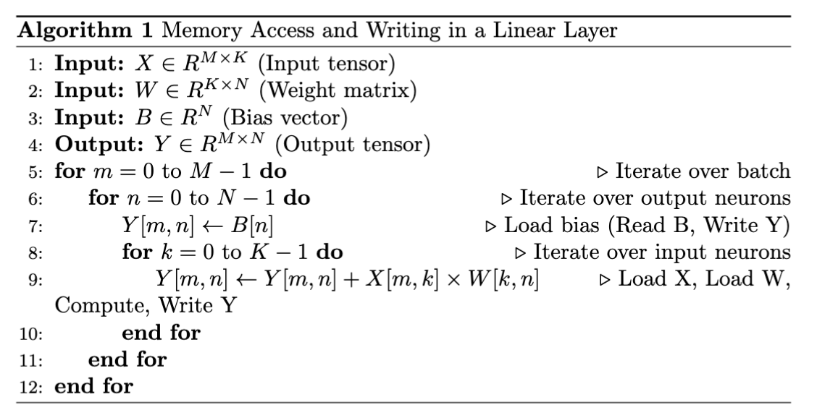
Memory Bottlenecks for AI Inference Workloads
A 70 Billion parameter model at Floating Point 16 precision requires 70 B * 2 Bytes = 140 GB of memory.
Model Inference consists mostly of Matrix–Matrix, Matrix–Vector Multiplies.
During Inference, all 140 GB of the model must be read from memory.
Memory read/write latency is critical for inference speed (GB/s). Can be improved by caching.
Notes:
Large AI models require significant memory bandwidth, with a 70 billion parameter model needing 140 GB for inference.
Inference mainly involves matrix–matrix and matrix–vector multiplications, making memory access a key constraint.
All parameters must be loaded from memory during inference, increasing latency and bandwidth demands.
Caching and memory-efficient architectures can help reduce bottlenecks and improve performance.

Slide 14
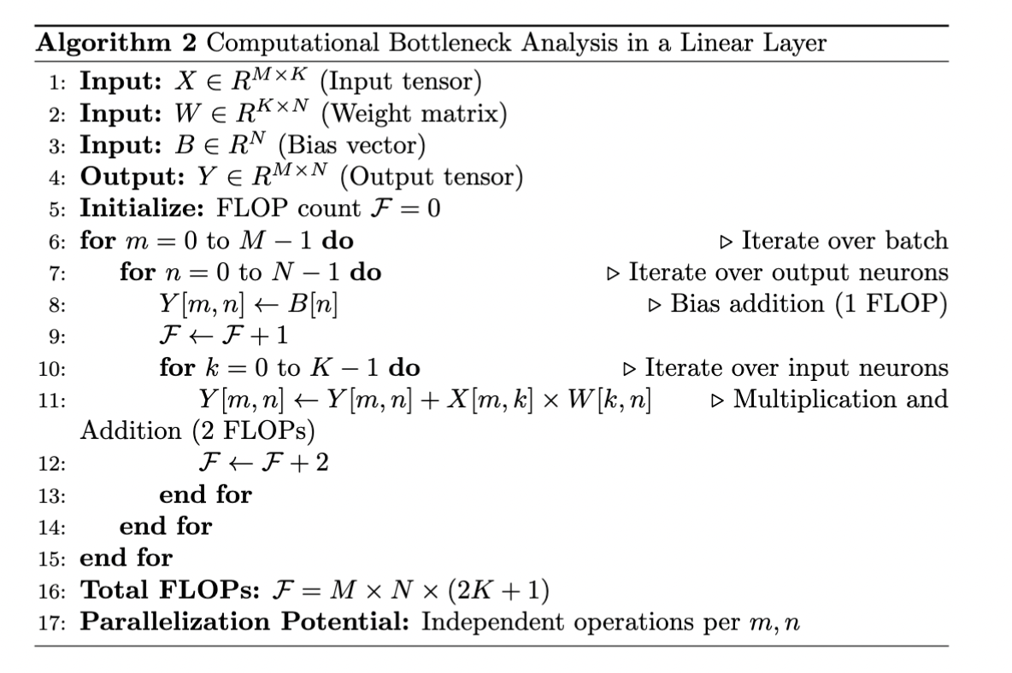
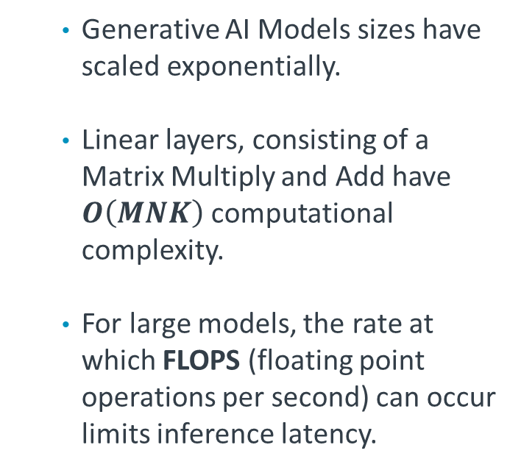
Computation Bottlenecks for AI Inference Workloads
Generative AI Models sizes have scaled exponentially.
Linear layers, consisting of a Matrix Multiply and Add have $O\left(MNK\right)$ computational complexity.
For large models, the rate at which FLOPS (floating point operations per second) can occur limits inference latency.
Notes:
Generative AI models have grown exponentially, increasing computational complexity.
Matrix multiplication and addition dominate inference workloads, with O(MNK) complexity.
Floating-point operations per second (FLOPS) determine computational efficiency and inference speed.
Parallelism and hardware-specific optimizations help mitigate computation bottlenecks.

Slide 15
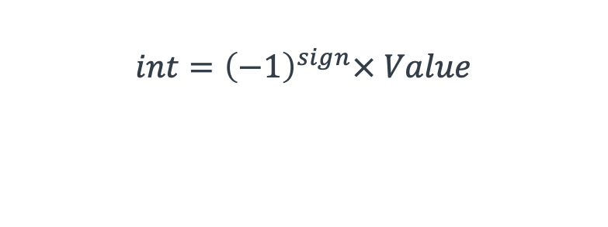
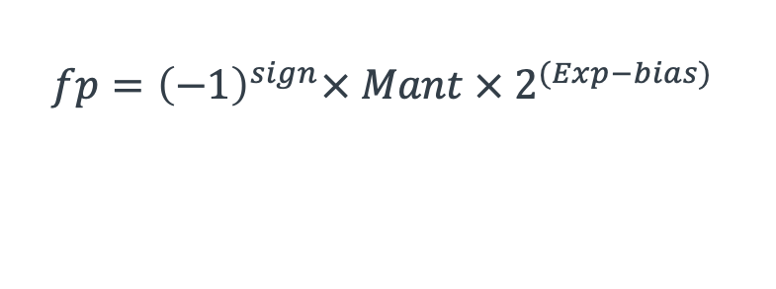
Techniques to Mitigate Memory Constraints
Sign bits
Value bits
Quantization (fp32 -> fp16/bf16 -> int8 -> int4)
Reduces bit width of parameters to lower memory and compute cost.
Minimizes memory bandwidth load when reading model parameters.
Can be applied post-training or during training with quantization-aware training (QAT).
Exponent bits
Mantissa bits
int4
int8
$$int={\left(−1\right)}^{sign}× Value$$
$$fp={\left(−1\right)}^{sign}× Mant × 2^{(Exp−bias) }$$
bf16
fp16
fp32
Notes:
Reducing parameter bit width (FP32 → FP16/BF16 → INT8 → INT4) lowers memory usage and compute cost.
Quantization decreases memory bandwidth load, improving efficiency for inference workloads.
Lower precision models require careful tuning to maintain accuracy.
Quantization can be applied post-training or during training with quantization-aware training (QAT).

Slide 16


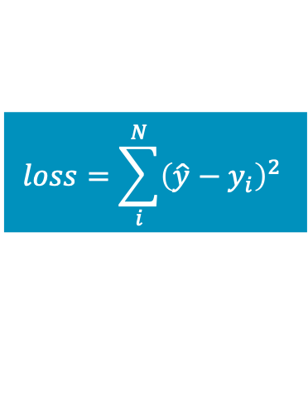
Techniques to Mitigate Memory Constraints
Knowledge Distillation
Compresses a large model into a smaller, efficient model.
A teacher model supervises a student model, transferring knowledge.
Types of knowledge:
feature-based knowledge
logit-based knowledge
relation-based knowledge.
Benefits: Reduces parameter count → lower memory and compute cost.
Text, Audio or Image inputs
Teacher
$$loss=\sum_{i}^{N}{{\left({\hat{y}−y}_{i}\right)}^{2}}$$
Student
Notes:
A large model can be compressed into a smaller, efficient student model while retaining performance.
The student model learns from a teacher model, reducing computational and memory requirements.
Different distillation methods exist, such as feature-based, logit-based, and relation-based distillation.
Knowledge distillation helps lower latency and energy consumption for AI inference.

Slide 17
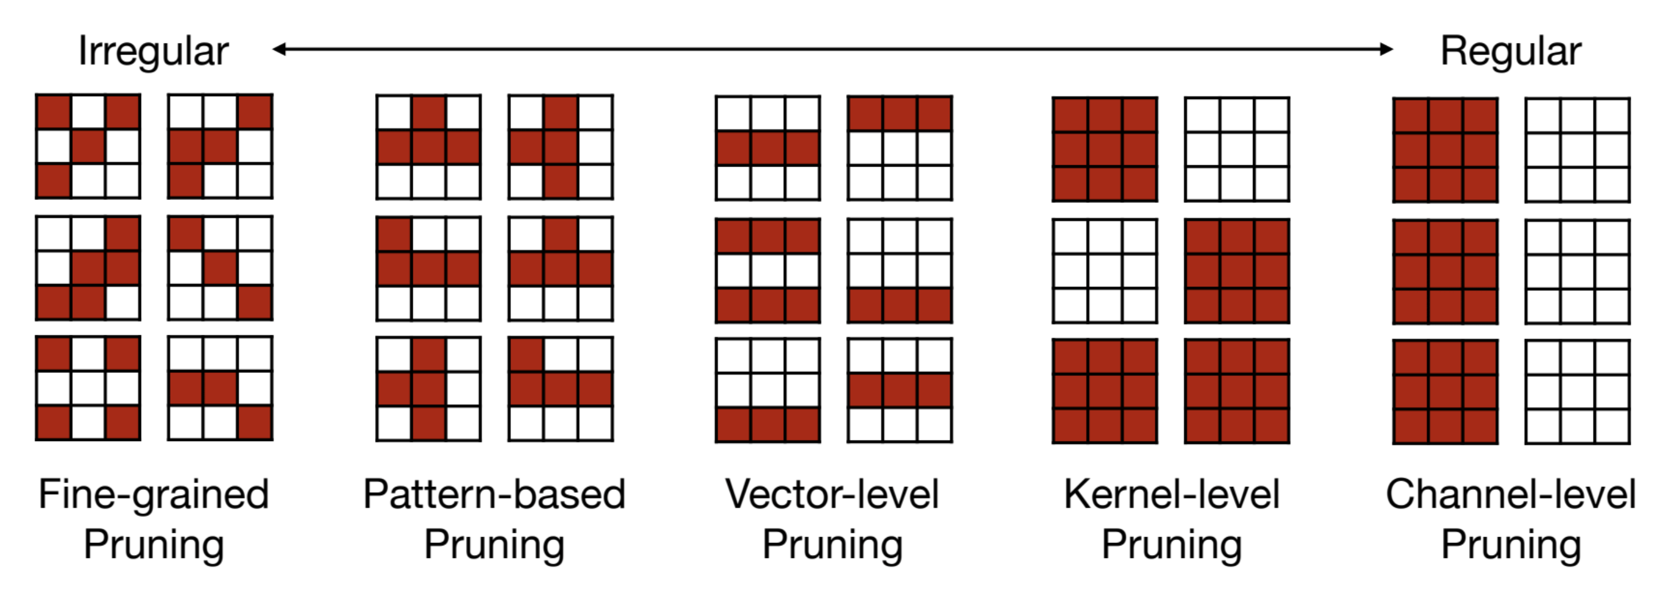
Techniques to Mitigate Memory Constraints
Pruning
Removes redundant parameters, groups, or entire layers of a neural network.
Techniques include:
L1/L2 norm-based pruning (removes small weights)
First-Order Pruning (removes weights, least affecting loss given by first order loss approximation)
Second-Order Pruning (removes weights, least affecting loss given by second order loss approximation).
Mao, H., et al. (2017, May 21-26). Exploring the granularity of sparsity in convolutional neural networks. Proceedings of the IEEE Conference on Computer Vision and Pattern Recognition Workshops. https://doi.org/10.1109/CVPRW.2017.241
Notes:
Pruning removes redundant parameters, groups, or layers to reduce model size and improve efficiency.
Techniques include L1/L2 norm-based pruning, first-order pruning, and second-order pruning.
Structured pruning helps maintain efficient execution while reducing unnecessary computations.
Sparse models require optimized hardware or software to fully utilize their advantages.

Slide 18
Summary of Key Points
Hardware Characteristics
CPU: versatile, low-latency cores optimized for latency-sensitive tasks (Including Advanced SIMD Features such as Neon, I8MM, DotProd, SME)
GPU: Large numbers of parallel cores using SIMD/SIMT execution, optimized for throughput.
Challenges and Solutions in AI Inference
Generative Model Sizes are rapidly increasing, from millions to hundreds of billions of parameters.
Depending on the memory-bandwidth or FLOPS of the device, AI Inference workloads can either be memory-bound or compute-bound.
Optimization Techniques such as Quantization, Distillation, and Pruning help reduce memory, computation, and energy costs.
Notes:
CPUs handle latency-sensitive tasks efficiently, while GPUs are optimized for high-throughput parallelism.
AI inference workloads can be either memory-bound or compute-bound, depending on hardware constraints.
Generative model sizes are increasing rapidly, demanding more memory and computational efficiency.
Optimization techniques such as quantization, distillation, and pruning help reduce memory, computation, and energy costs.

Slide 19
Questions and Discussion

